Slide 1
Introduction to Quantum Chemistry
Quantinuum Winter School
Nathan Fitzpatrick
Date

Slide 2
VARIATIONAL PRINCIPLE
The energy expectation value of the Hamiltonian of an operator for a given state is given by in an orthogonal basis:
Therefore or the ground state:

Slide 3
VARIATIONAL PRINCIPLE
Taking the expectation value in the finite basis
Subtracting E₀ from both sides, one obtains:

Slide 4
VARIATIONAL PRINCIPLE
Taking the expectation value in the finite basis
Subtracting E₀ from both sides, one obtains:

Slide 5
VARIATIONAL PRINCIPLE
Taking the expectation value in the finite basis
For E_{n} - E₀ > 0 and therefore for finite K:
E = E_{0 c}an only be satisfied for infinite expansion (complete basis set).

Slide 6
VARIATIONAL PRINCIPLE
Therefore when we vary the basis expansion cs we have the famous variational principle:
This is the corner stone of quantum chemistry
This is why VQE works and we can used variational minimizations for ground states
Can be generalised to excited states
Exercise

Slide 7
Secular Equation
We often format this as a matrix equation
Where

Slide 8
Secular Equation
We then differentiate the parameters = 0
This equation is satisfied by and hence at the minimum energy
This is an extremely powerful result and means diagonalising the Hamiltonian will always give the optimum parameter eigenvectors and eigenvalues

Slide 9
Computational Chemistry Methods
Depending on your resources and system size
Simplify the basis expansion
Simplify the Hamiltonian

Slide 10
Molecular Energies
Electrons move in the the potential of fixed nuclei
Decreasing contributions
Focus on Electronic Energy

Slide 11
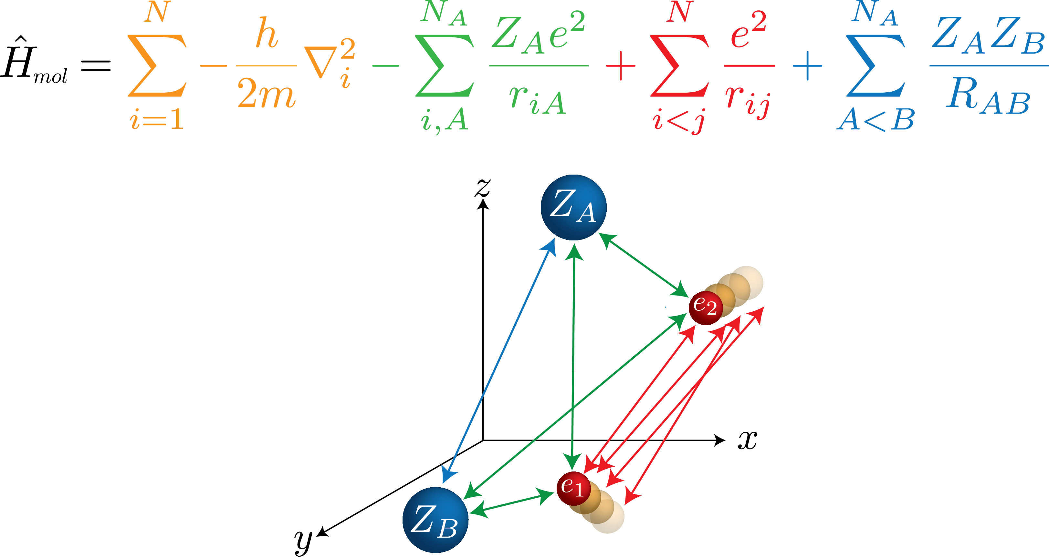
MOLECULAR Electronic HAMILTONIAN
Nuclear – nuclear repulsion
Electron kinetic energy
Electron - nuclear attraction
Electron - electron repulsion

Slide 12
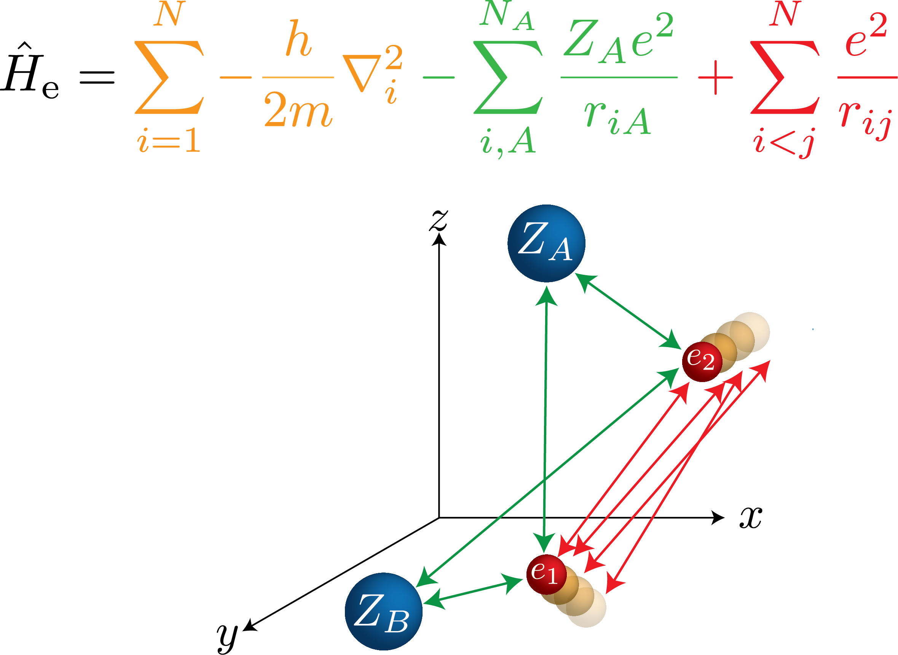
Electronic HAMILTONIAN
Electron kinetic energy
Electron - nuclear attraction
Electron - electron repulsion

Slide 13
Electronic HAMILTONIAN
Separable
Not Separable!
Instantaneous positions effected
by each other

Slide 14
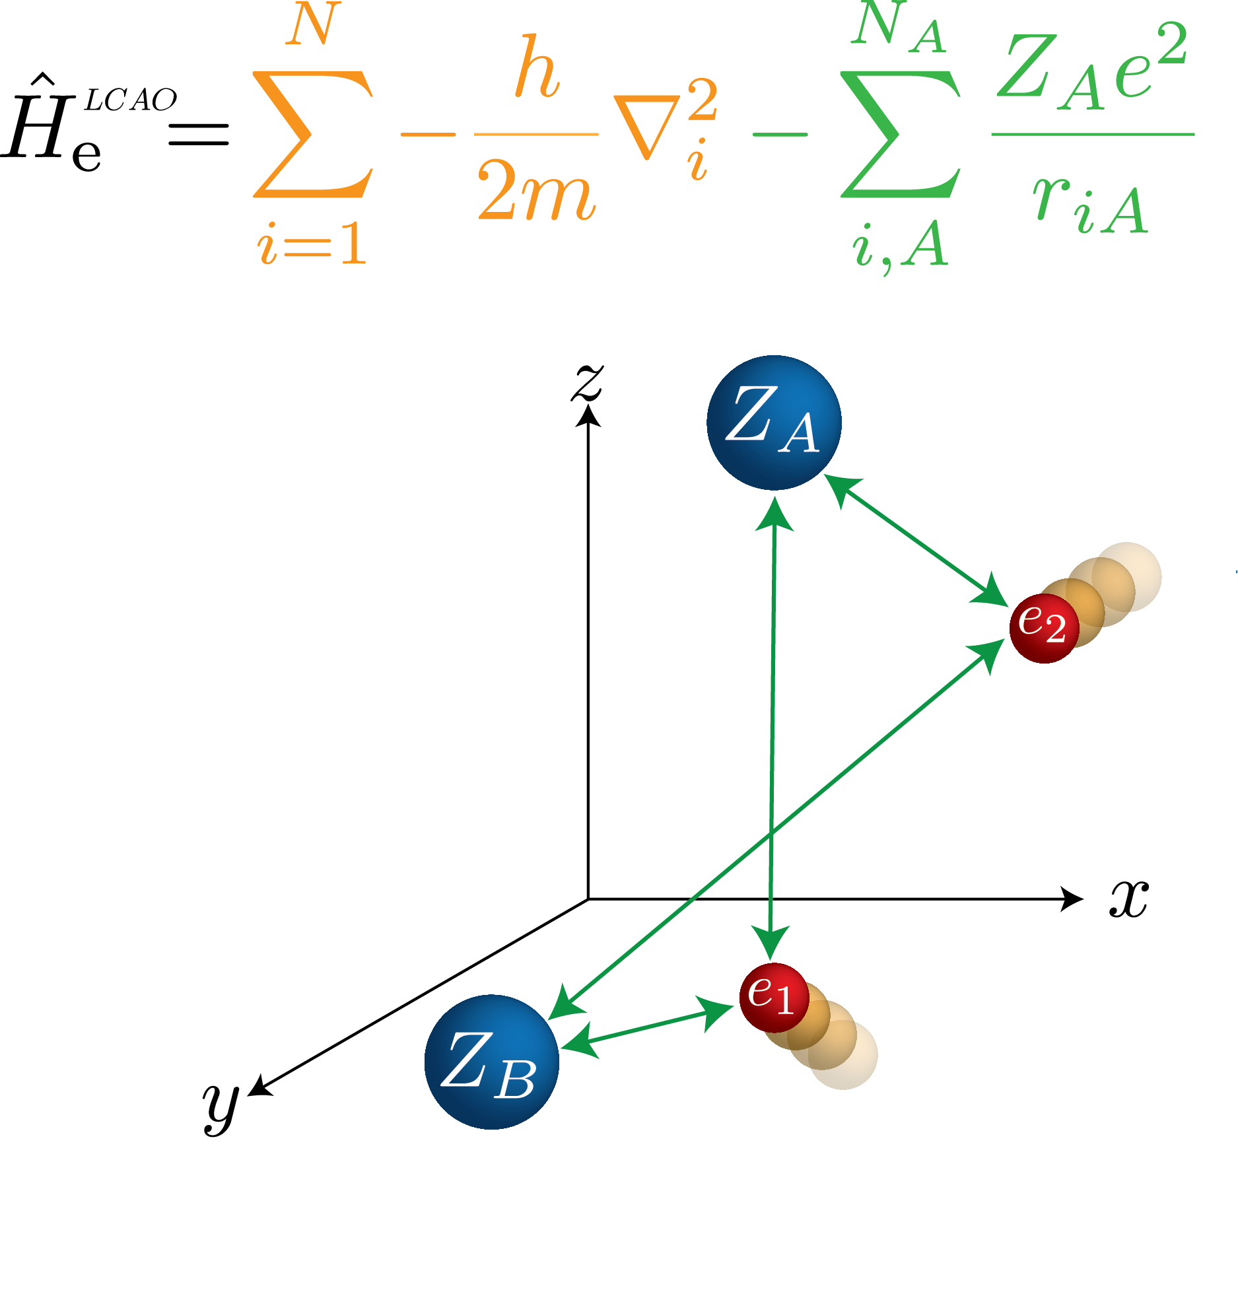
LCAO HAMILTONIAN
Electron kinetic energy
Electron - nuclear attraction

Slide 15
LCAO HAMILTONIAN
Separable!
Each electron orbital can therefore be solved in as an element in the product wavefunction.
Can use analytical eigenfunctions from Hydrogen like atomic orbitals as a basis
However will not be exact solutions due to extra nuclear-electronic interactions

Slide 16
Linear combination of Atomic Orbitals
In LCAO we consider the separable non interacting electron Hamiltonian
We can therefore solve for individual Molecular orbital system with the secular equation
We can build up a Molecular bonding picture with the Hydrogen-like atomic orb
Bad Quantitative picture
Used Qualitatively very well by most chemists to get a rough idea of reactions

Slide 17
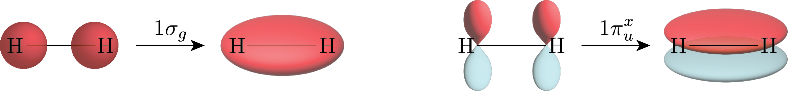
Linear combination of Atomic Orbitals
Consider 2 1s orbitals of hydrogen mixing
We can build up a Molecular bonding picture with the Hydrogen-like atomic by find in the c parameters
In most conditions can consider 1s separately due to symmetry. (Still incomplete).

Slide 18
Linear combination of Atomic Orbitals
Move over terms
Solving the secular determinant
1Sa and 1SB not orthogonal in space as different nucli position

Slide 19
Linear combination of Atomic Orbitals
Solving the secular determinant
1Sa and 1SB not orthogonal in space as different nucli position
Energy splitting a largely governed by overlap of bonding orbital pair

Slide 20
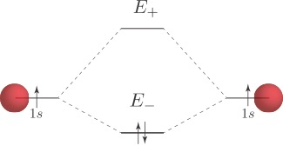
Linear combination of Atomic Orbitals
Energy splitting
Energy splitting a largely governed by overlap of bonding orbital pair in denom
Antibonding
Bonding

Slide 21
Linear combination of Atomic Orbitals
Solve Quadratic equation
Kato theorem for electron density cusps(singularities)

Slide 22
Linear combination of Atomic Orbitals
Overlap
Overlapping area in r

Slide 23
Linear combination of Atomic Orbitals
Hamiltonian elements
Exercise

Slide 24
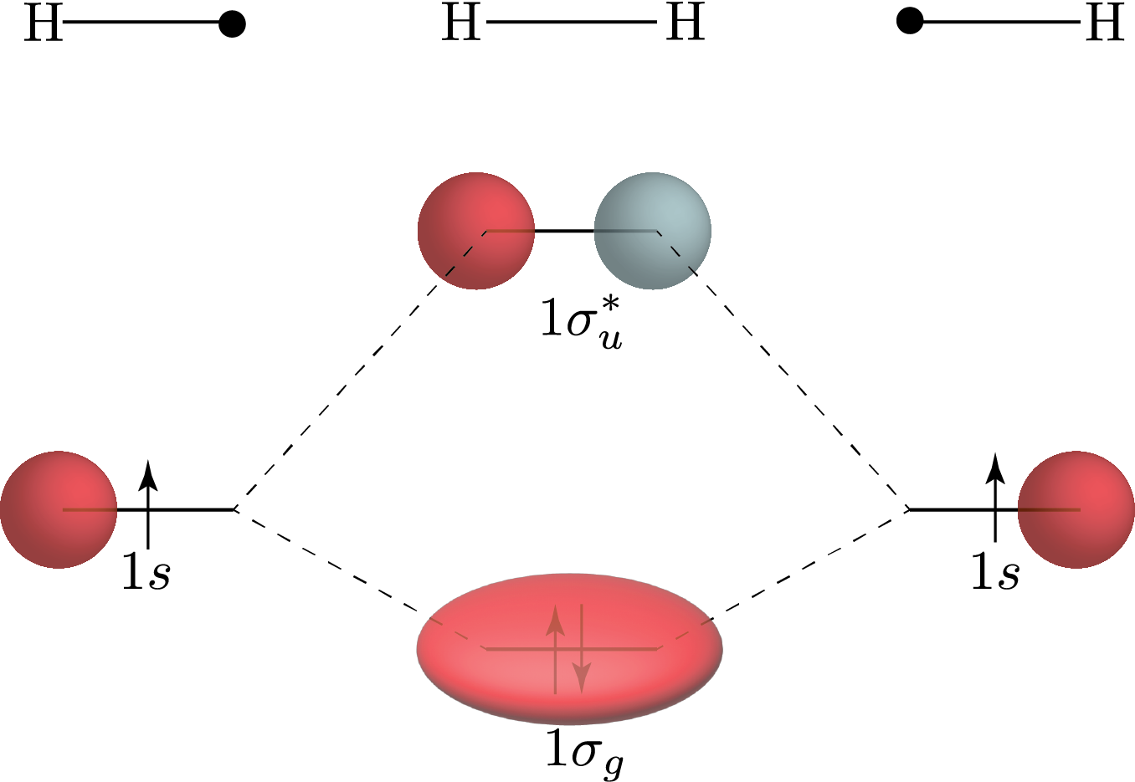
Linear combination of Atomic Orbitals
Qualitative MO diagram. Gives enough picture for Chemists
Two atomic orbitals of the correct symmetry form a bonding and anti bonding pair
Antibonding
Bonding

Slide 25
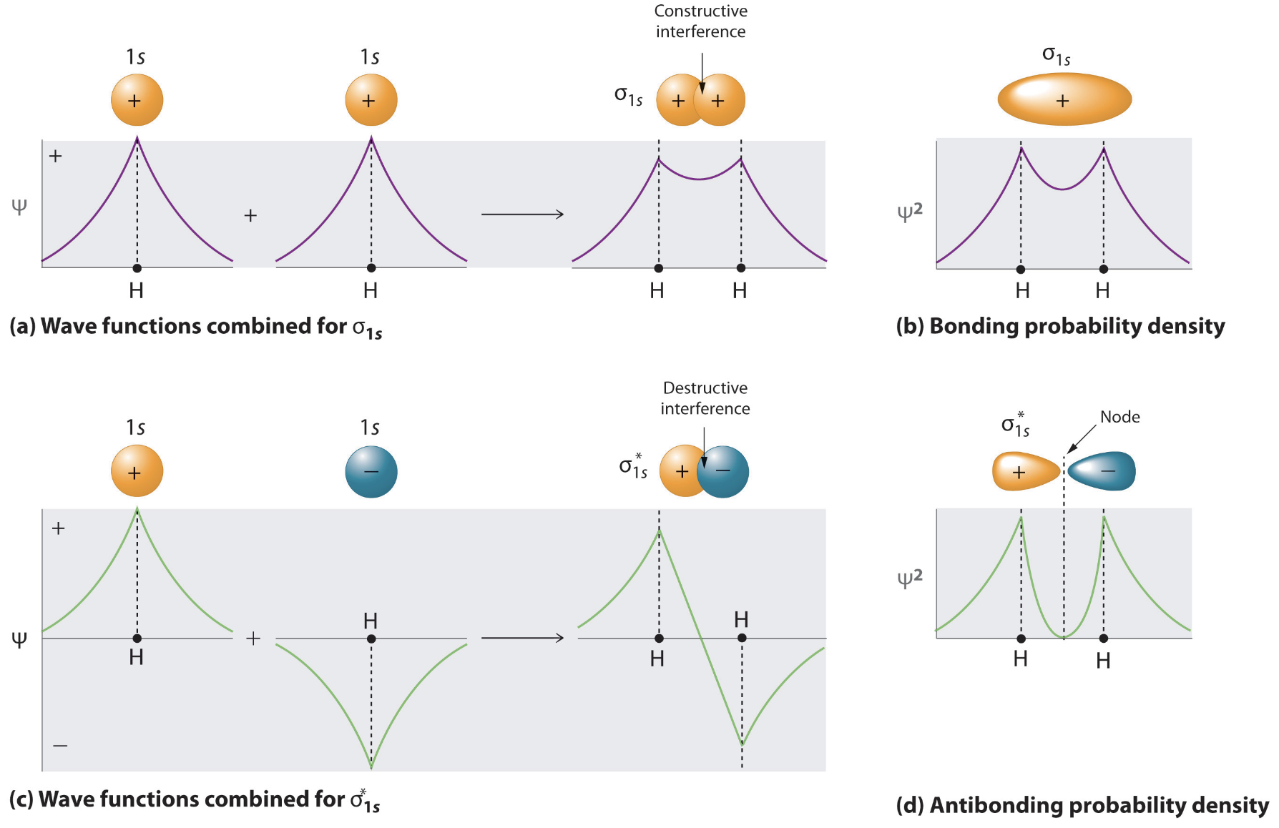
Linear combination of Atomic Orbitals

Slide 26
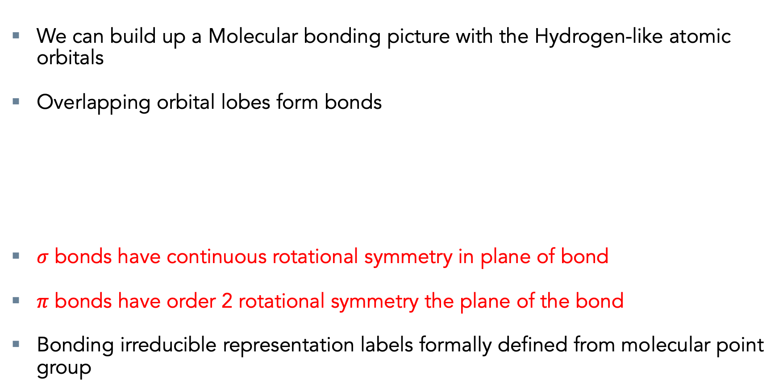
Linear combination of Atomic Orbitals
We can build up a Molecular bonding picture with the Hydrogen-like atomic orbitals
Overlapping orbital lobes form bonds
$σ$ bonds have continuous rotational symmetry in plane of bond
$π$ bonds have order 2 rotational symmetry the plane of the bond
Bonding irreducible representation labels formally defined from molecular point group

Slide 27
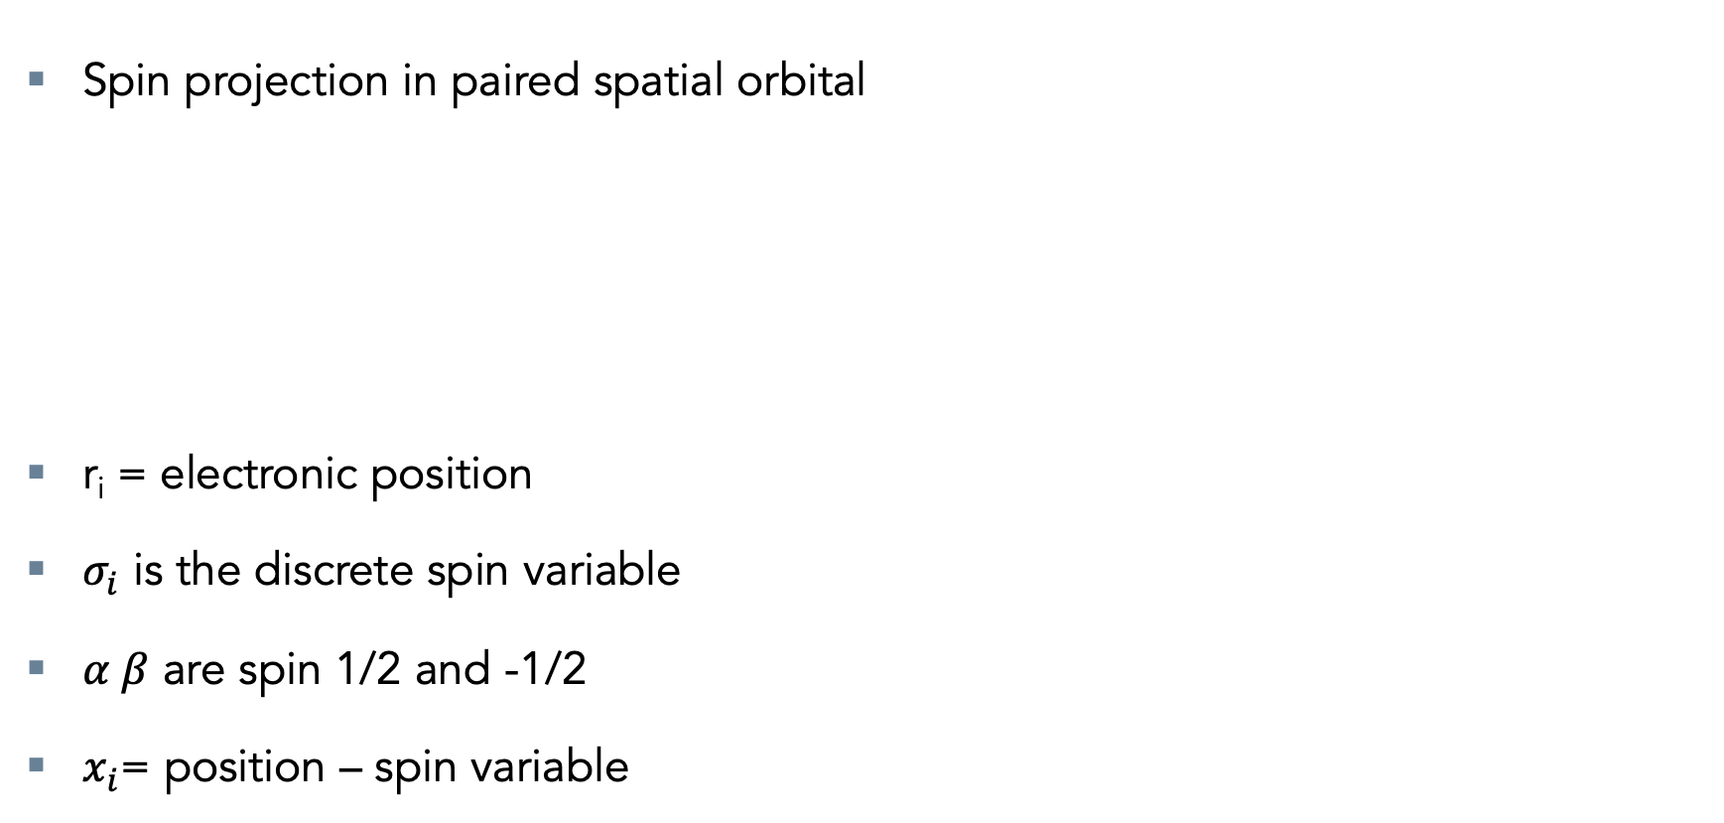
Spin Orbitals
Spin projection in paired spatial orbital
r_{i} = electronic position
$σ_{i}$ is the discrete spin variable
$α β$ are spin 1/2 and -1/2
$x_{i}$= position – spin variable

Slide 28
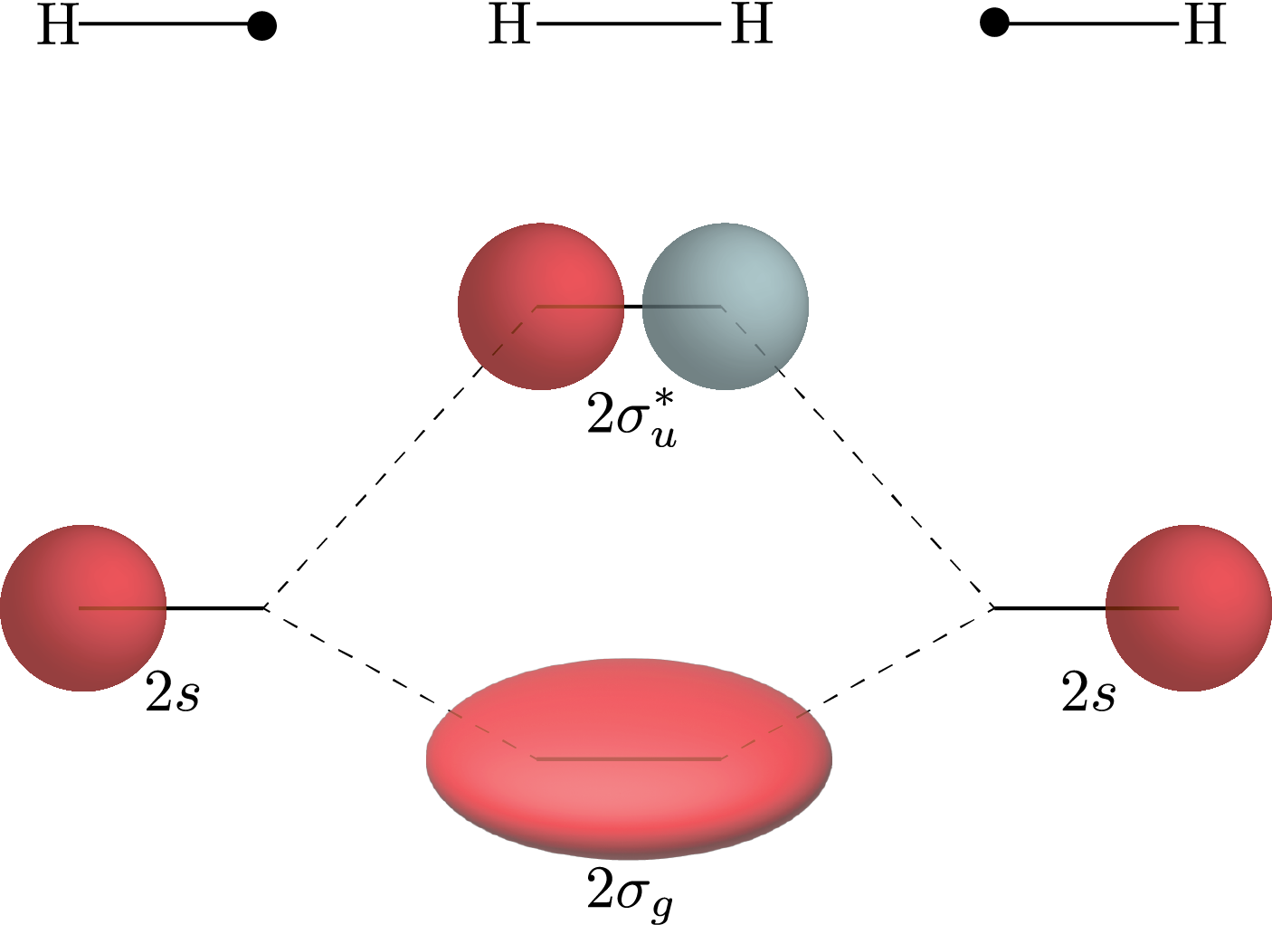
Linear combination of Atomic Orbitals
AOs of higher principle quantum number higher in energy
More diffuse (Bigger) and further from the attractive nucleus

Slide 29
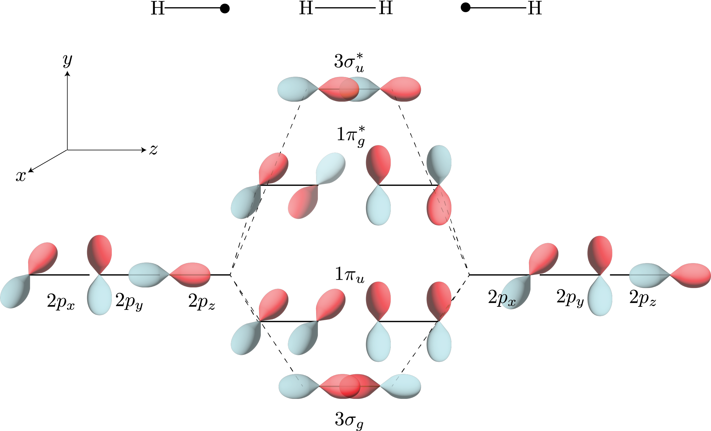
Linear combination of Atomic Orbitals
p orbitals have $σ$ and $π$ bonding

Slide 30
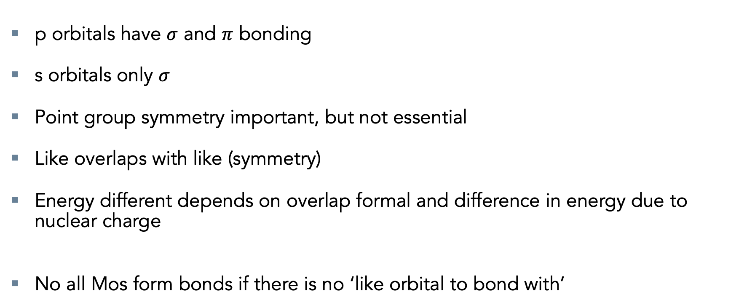
Rule Book For MO Theory
p orbitals have $σ$ and $π$ bonding
s orbitals only $σ$
Point group symmetry important, but not essential
Like overlaps with like (symmetry)
Energy different depends on overlap formal and difference in energy due to nuclear charge
No all Mos form bonds if there is no ‘like orbital to bond with’

Slide 31
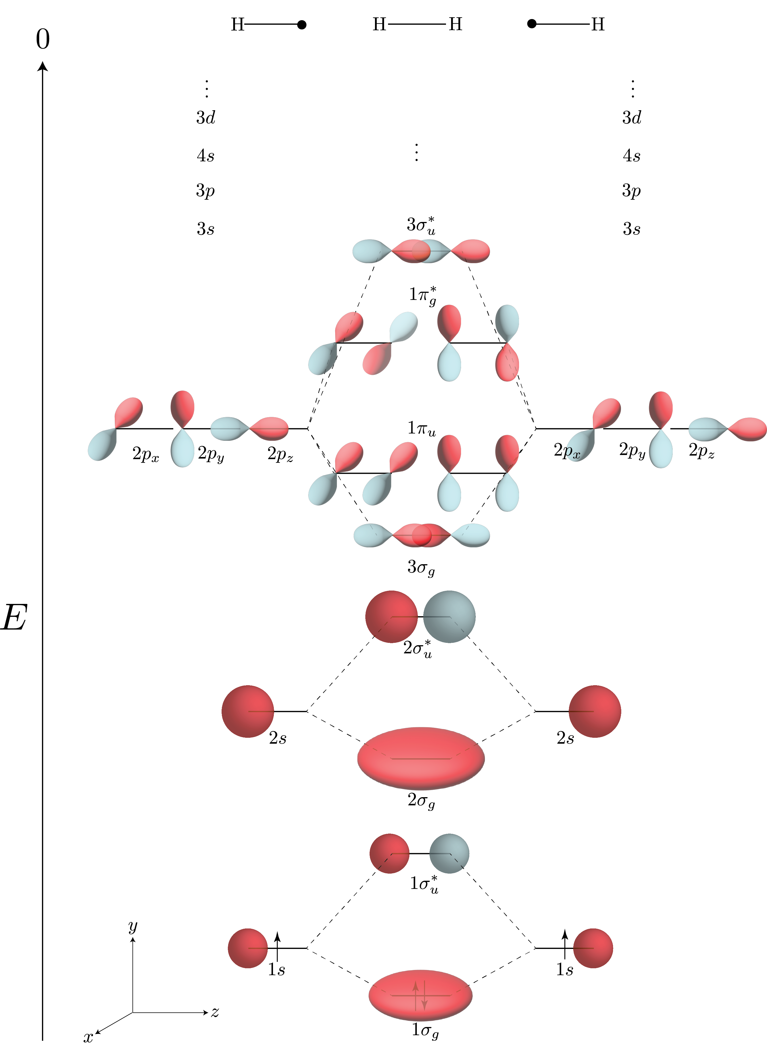
Bonding
0 = ionisation
Larger Molecules are more complicated to visualise
Diagrammatic visualisation only really works two fragments
Theory holds for more than two fragments
Infinite Orbital solutions (Complete basis)

Slide 32
Bonding
0 = ionisation
Larger Molecules are more complicated to visualise
Diagrammatic visualisation only really works two fragments
Theory holds for more than two fragments
Infinite Orbital solutions (Complete basis)

Slide 33
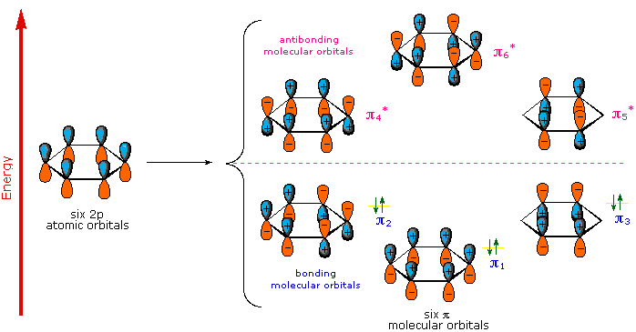
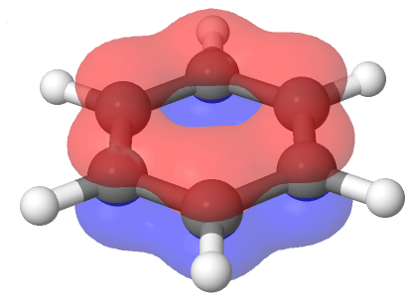
Benzene

Slide 34
Conclusions
Derived a (Bad) quantitative bonding picture using Molecular Orbitals MO
Gives a pictorial qualitive picture of bonding
Used by chemists when thinking of chemical reactions
So called chemical intuition
Non interacting theory gives bad energy values
Need a better theory for quantitative values why try

Slide 35
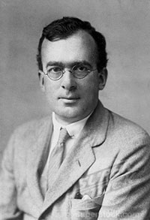

Douglas Hartree
Learnt about differential equations during the first world war
Applied these ideas to Schrodinger equation
First solutions with electron mean field potential in

Slide 36
Atomic Units
Constant nuclear repulsions removed
Hartree unit of energy

Slide 37
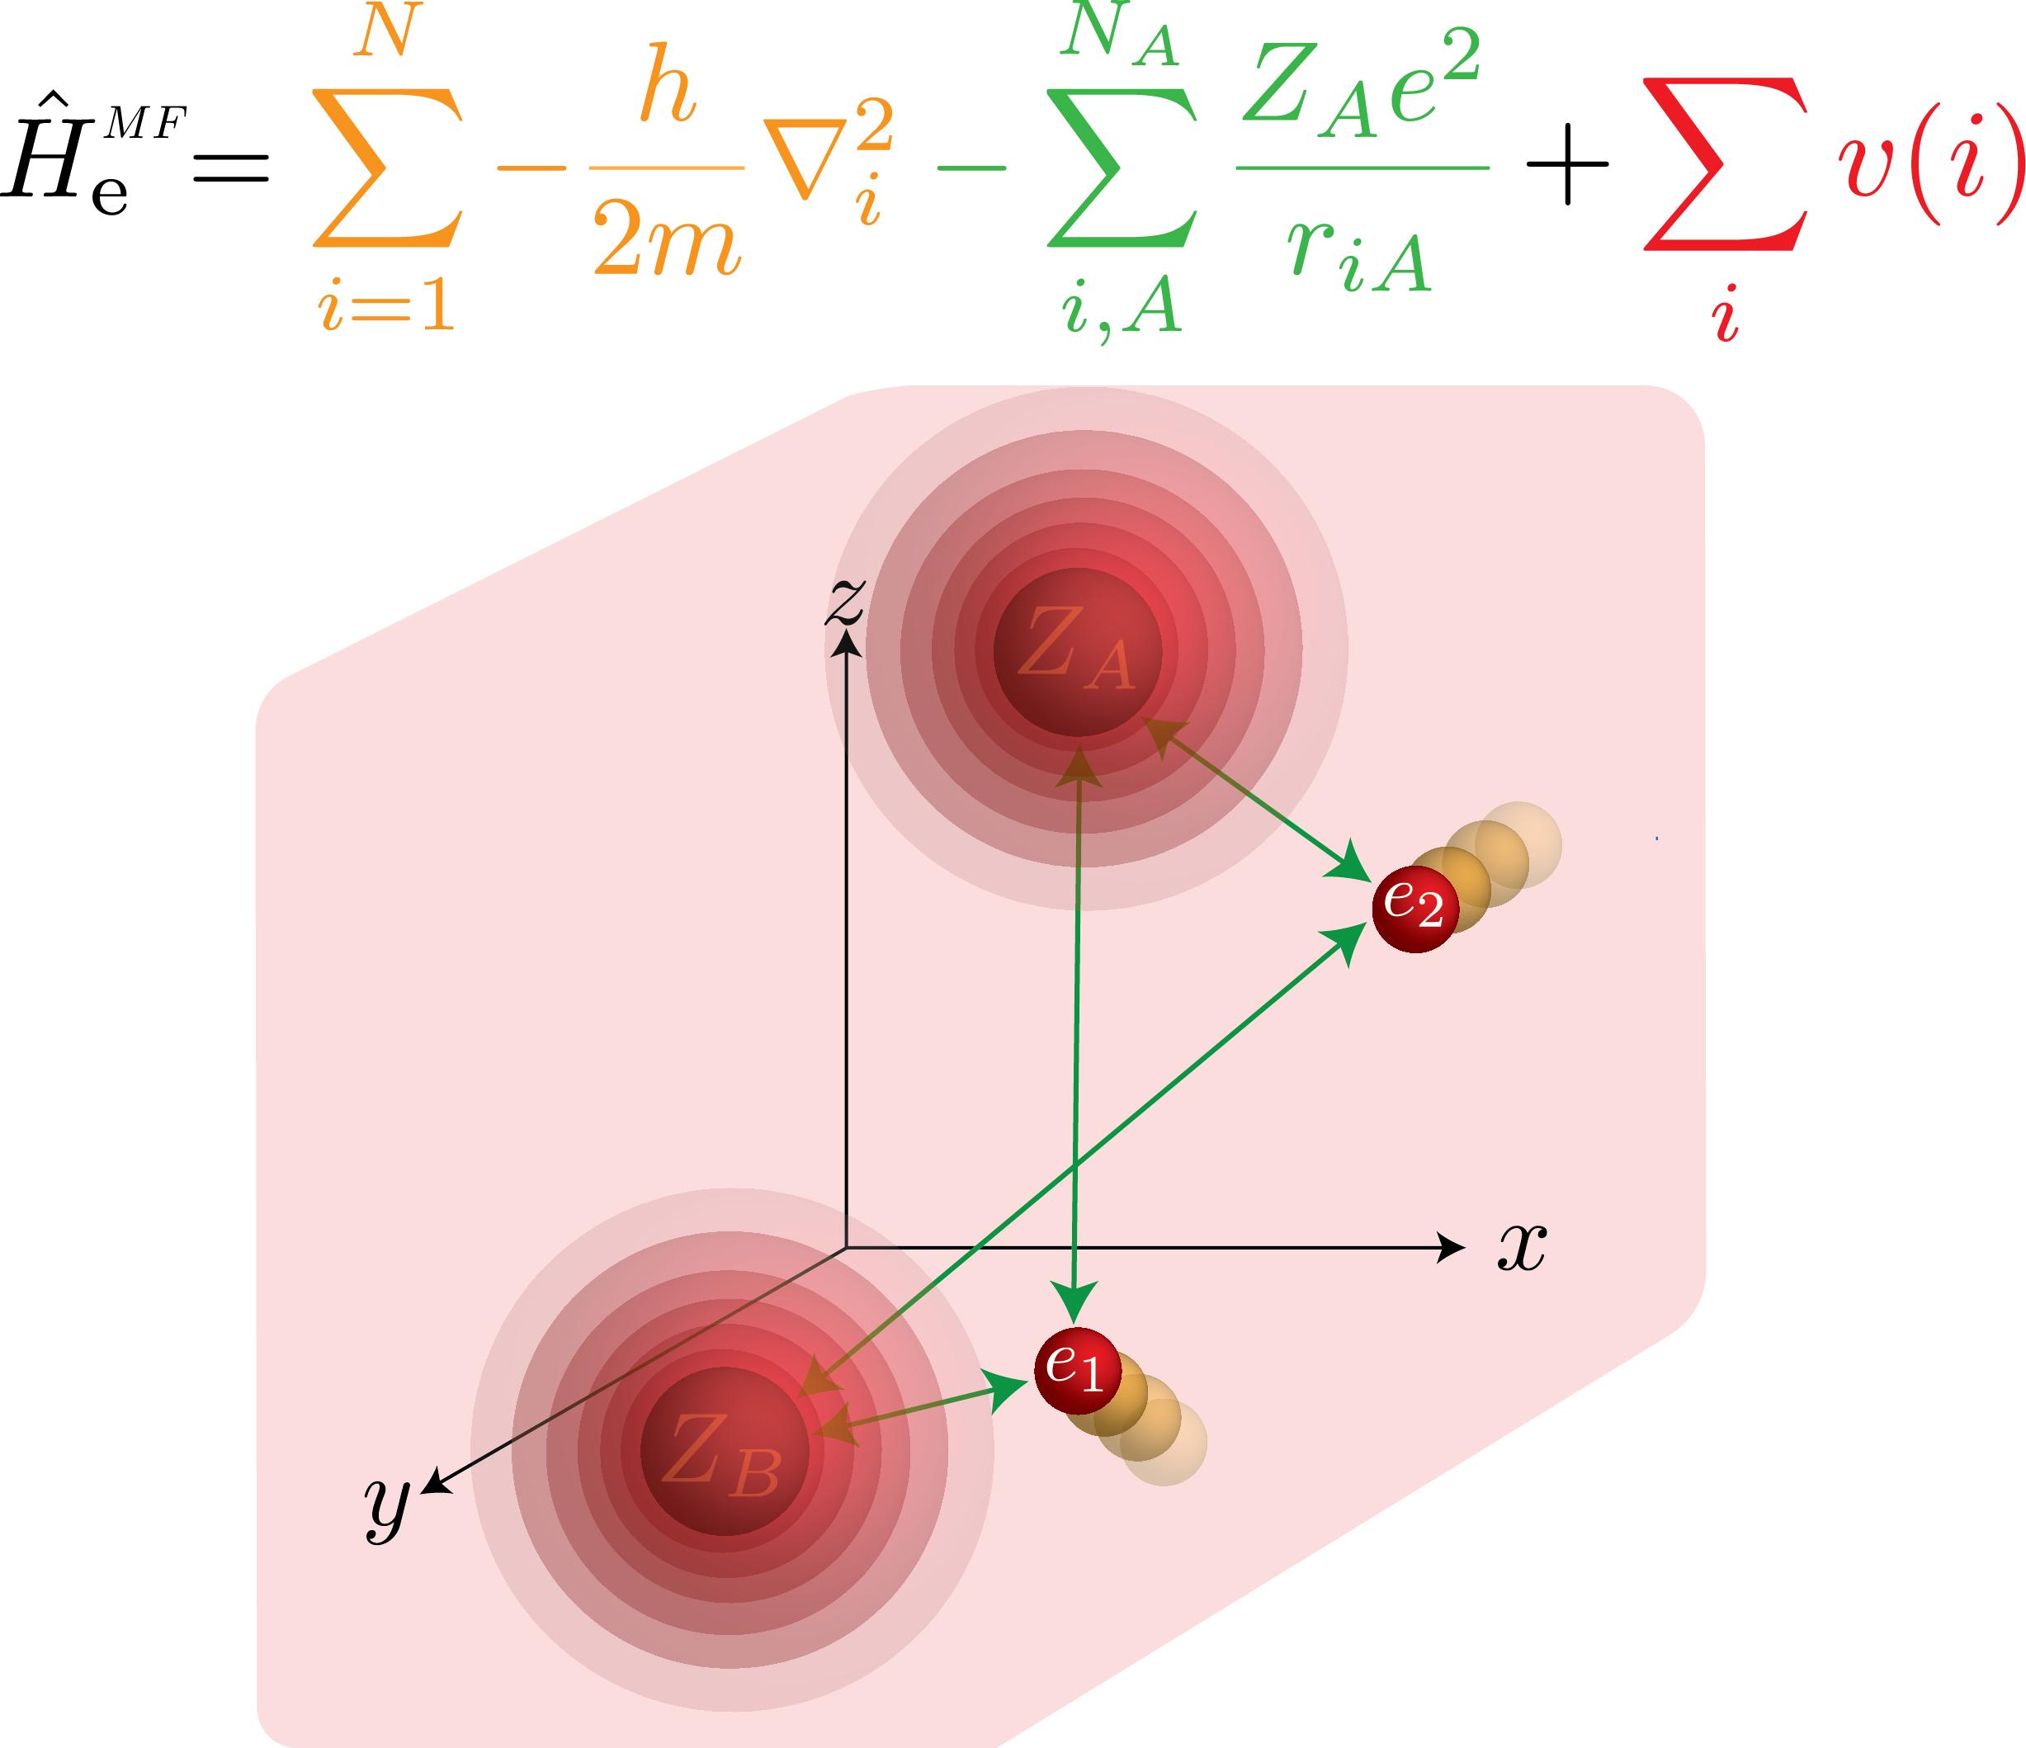
Mean FEild Approximation

Slide 38
Mean Field Hamiltonian
Mean field potential – average over all other electron not i
Where the electron density is defined as:

Slide 39
Mean Field Approximation

Slide 40
Hartree Product
Mean Field Hamiltonian separable
Calculate WF for each single electrons p in state pi
Many particle WF constructed as a product of exact single particle wavefunction
Approximate mean field approximation
Not Antisymmetric, electrons distinguishable, very wrong

Slide 41
Separable differential equations
Separable non interacting operator (Single particle)
Each particle can therefor be treated with it own equation independently
Still in analytic differential equations picture
Non linear in the spin orbitals
Must be iterated over until the mean field converges (self consistency feedback loop)

Slide 42
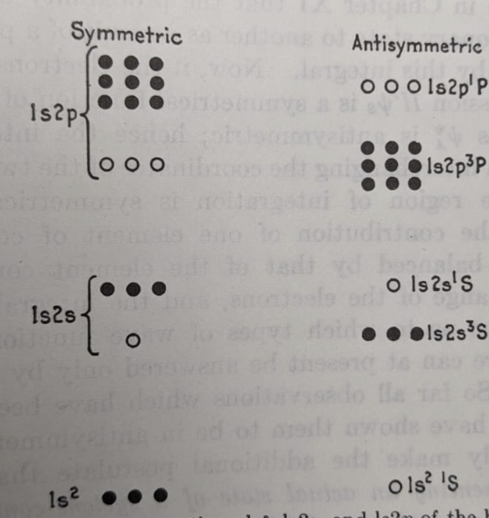
NoN PhYsical Solutions
When applied to Helium this method general more solutions than observed by experiment
Only the antisymmetric solutions are in nature.
Need a method to take account for this!

